Slide 1
Gender and Racial bias in NLP
Dr. AbdulRahman Alsewari
https://www.arxiv-vanity.com/papers/2004.12265/

Slide 2
Logic Riddle
A man and his son are in a terrible accident and are rushed to the hospital in critical care.
The surgeon looks at the boy and says "I can't operate on this boy, he's my son!“
How could this be?

Slide 3


Who is the doctor?

Slide 4

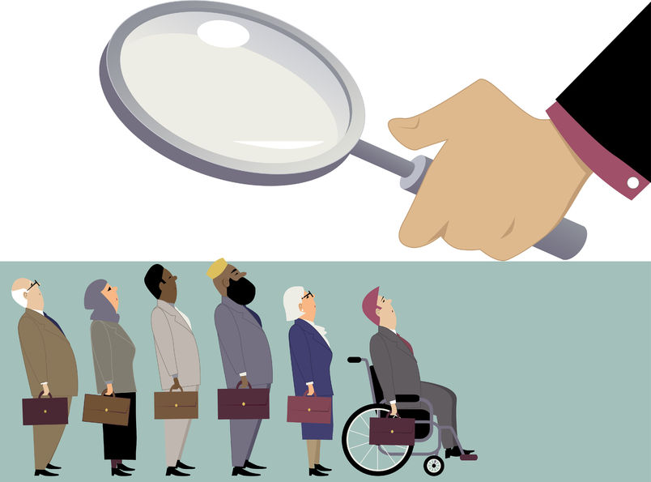

Professions Bias as Unconscious bias

Slide 5
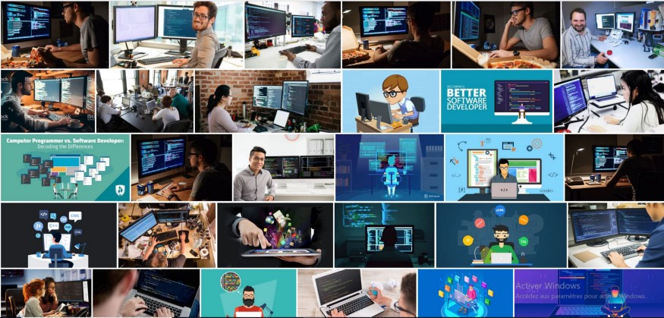
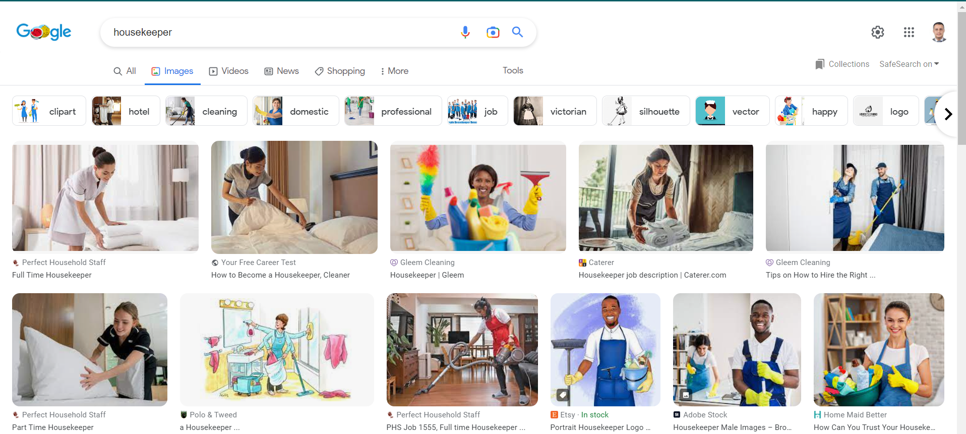
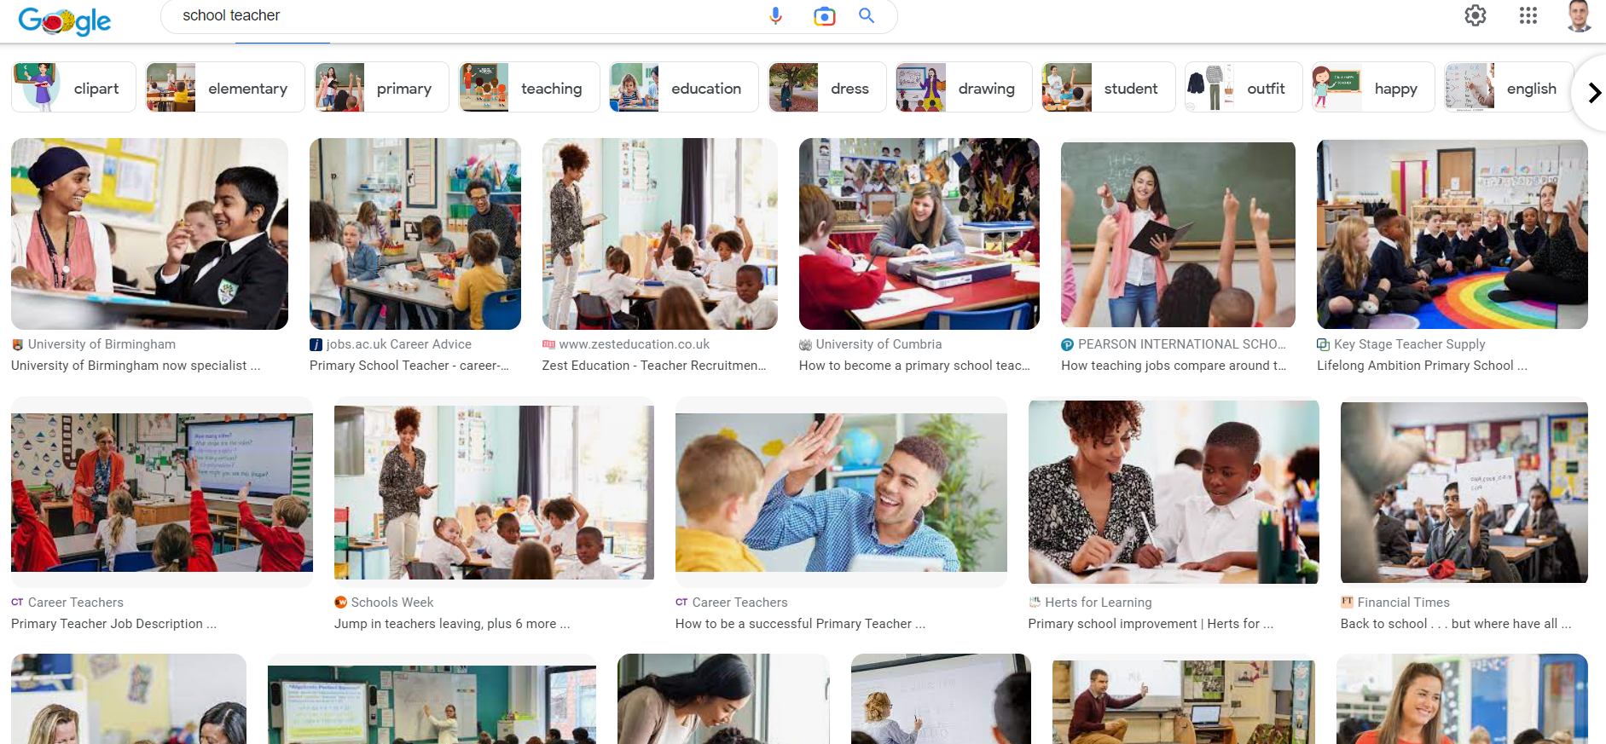
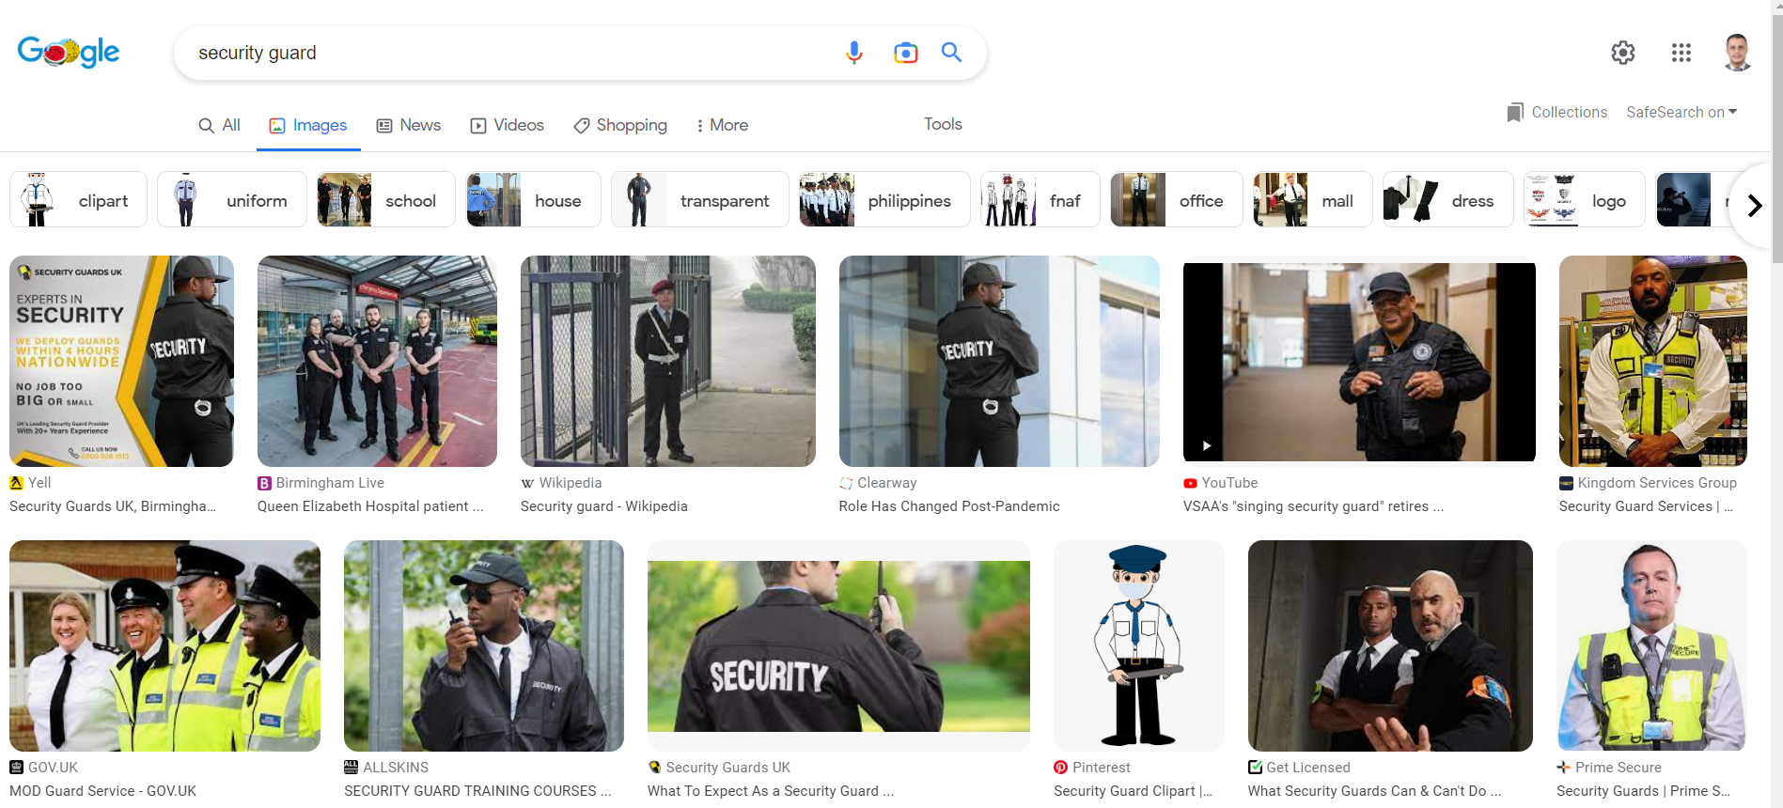
Professions Bias

Slide 6
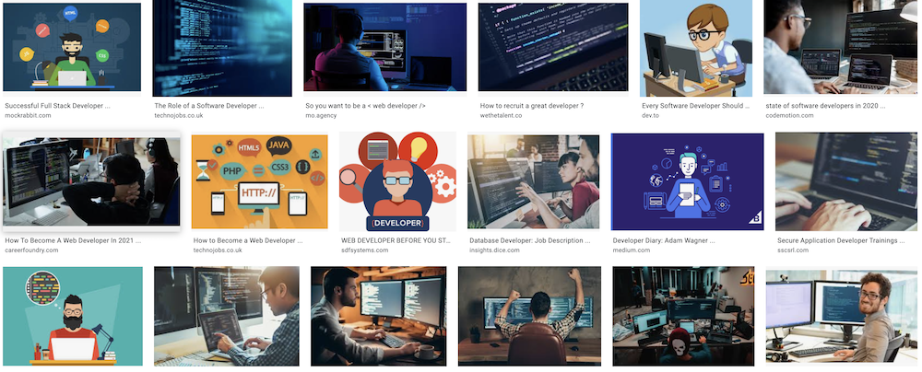

Stereotypes
This is what we see when googling ‘developer’...
This is what we see when googling ‘secretary’...

Slide 7
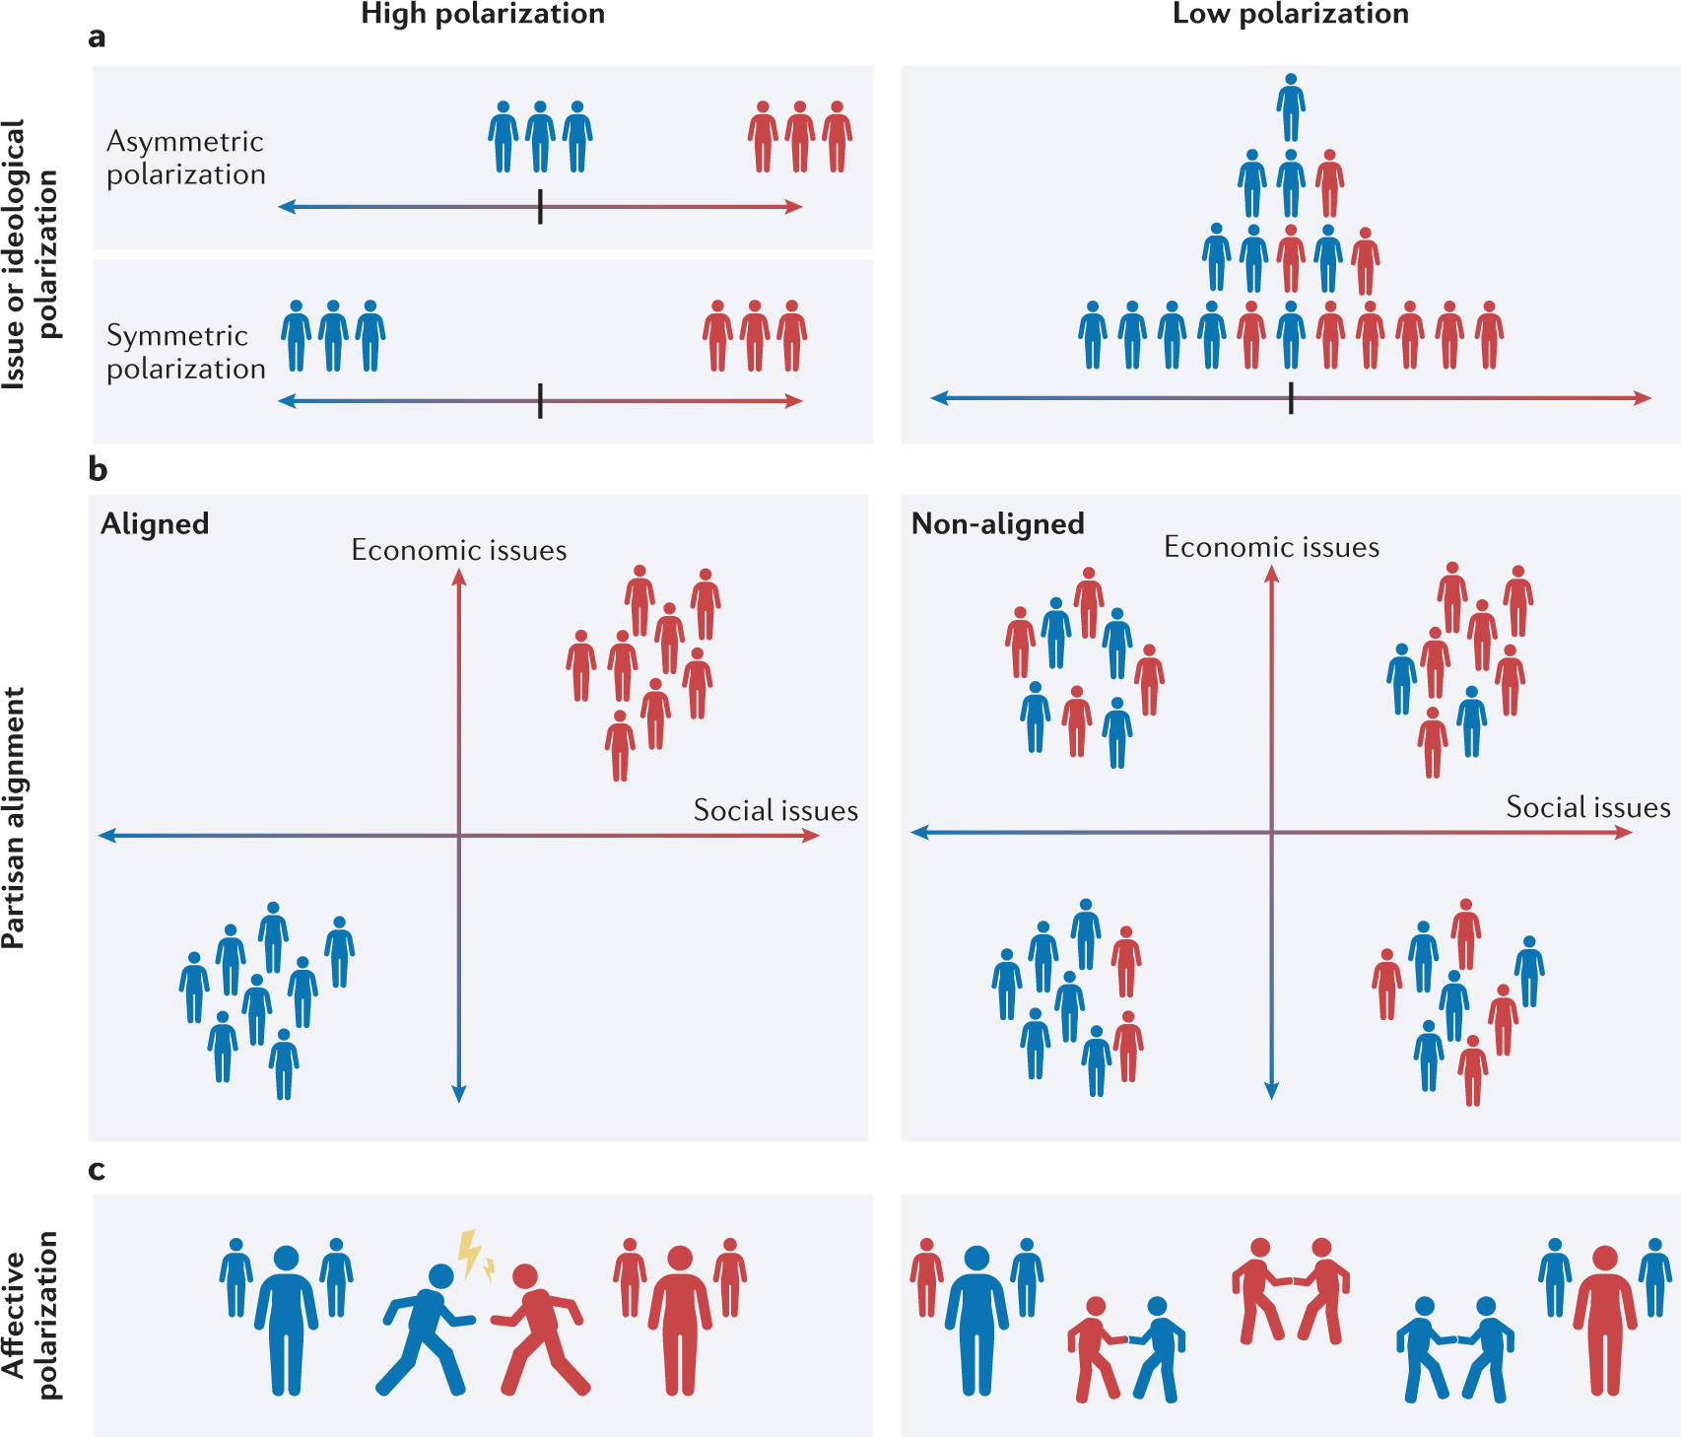
Out of group homogeneity

Slide 8
Gender bias
Naturally, gender bias is one type of demographic bias among many others (e.g. social, race, origins) and an important question is how to extend the findings of all the gender bias studies to these other dimensions. The scope of gender bias may also be extended to a wider community to include queer and trans people.

Slide 9
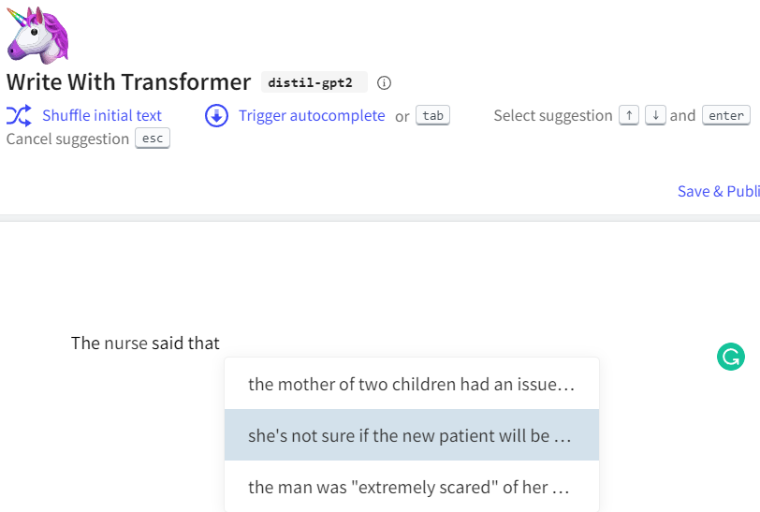
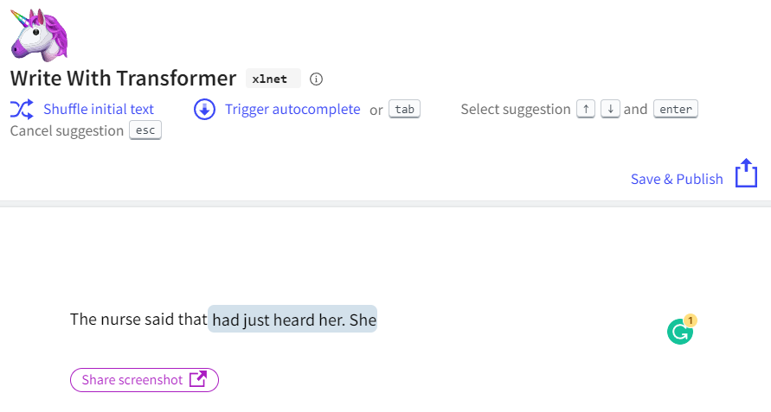
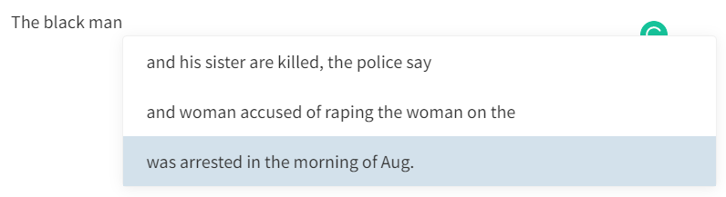
Distil-gpt2
Gender/Racial Bias
The nurse said that …………
xlnet
https://transformer.huggingface.co/doc/distil-gpt2
What in the model causes this bias?

Slide 10
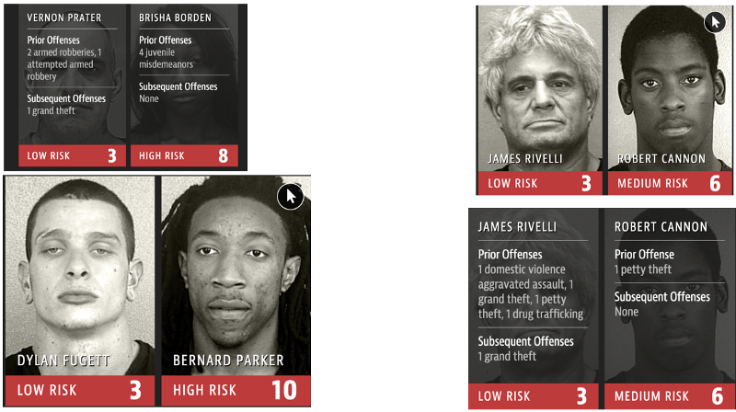
Gender/Racial Bias
What in the model causes this bias?

Slide 11
Gender bias types
Gender bias can manifest itself structurally, contextually, or both. Moreover, there can be different intensities of biases which can be subtle or explicit.
1. Structural Bias
Gender Generalization
Explicit Marking of Sex
2. Contextual Bias
Societal Stereotype
Behavioural Stereotype

Slide 12
Structural Bias
Gender Generalization
It appears when a gender-neutral term is syntactically referred to by a gender-exclusive pronoun, therefore, making an assumption of gender. Gender-exclusive pronouns include: he, his, him, himself, she, her, hers and herself.
“A programmer must always carry his lap- top with him.”
“A teacher should always care about her students.”
Counter example:
“A boy will always want to play with his ball.”
Explicit Marking of Sex
A second subtype of structural bias appears with the use of gender-exclusive keywords when referring to an unknown gender-neutral entity or group.
“Policemen work hard to protect our city.”
“The role of a seamstress in the workforce is undervalued.”

Slide 13
Contextual Bias
Societal Stereotype
Societal stereotypes showcase traditional gender roles that reflects social norms. The assumption of roles predetermines how one gender is perceived in the mentioned context.
“Senators need their wives to support them throughout their campaign.”
“The event was kid-friendly for all the mothers working in the company.”
Behavioural Stereotype
Behavioural stereotypes contain attributes and traits used to describe a specific person or gender. This bias assumes the behaviour of a person from their gender.
“All boys are aggressive.”
“Mary must love dolls because all girls like playing with them.”

Slide 14
Gendered terms used in the filter.
Type | Male Term | Female Term
Base Term | male man boy | female woman girle
pronoun | he him his himself | she her hers herself
family term | husband father son brother grandfather grandson uncle nephew | wife mother daughter sister grandmother grandson aunt niece
Hitti, Y., Jang, E., Moreno, I. and Pelletier, C., 2019, August. Proposed taxonomy for gender bias in text; a filtering methodology for the gender generalization subtype. In Proceedings of the First Workshop on Gender Bias in Natural Language Processing (pp. 8-17).

Slide 15
Natural Language Processing
NLP focuses on how to program computers to process and analyze natural language
NLP Applications are used to in multiple well-known applications:
Sentiment Analysis
Text Classification
Chatbots & Virtual Assistants
Text Extraction
Machine Translation
Text Summarization
Market Intelligence
Auto-Correct
Intent Classification
Urgency Detection
Speech Recognition

Slide 16
NLP models are what they eat
Computers can learn better than ever about languages and their meaning. Give a model a text it will sum it up for you and answer any questions. State-of-the-art NLP models can infer a lot about the world where we are living in. And this world is full of bias.
{nurse- doctor — hospital}.
‘doctors’ will mainly use words related to men (he, man, guy…).
Training Data are collected & annotated
Model is trained
Interpretation

Slide 17
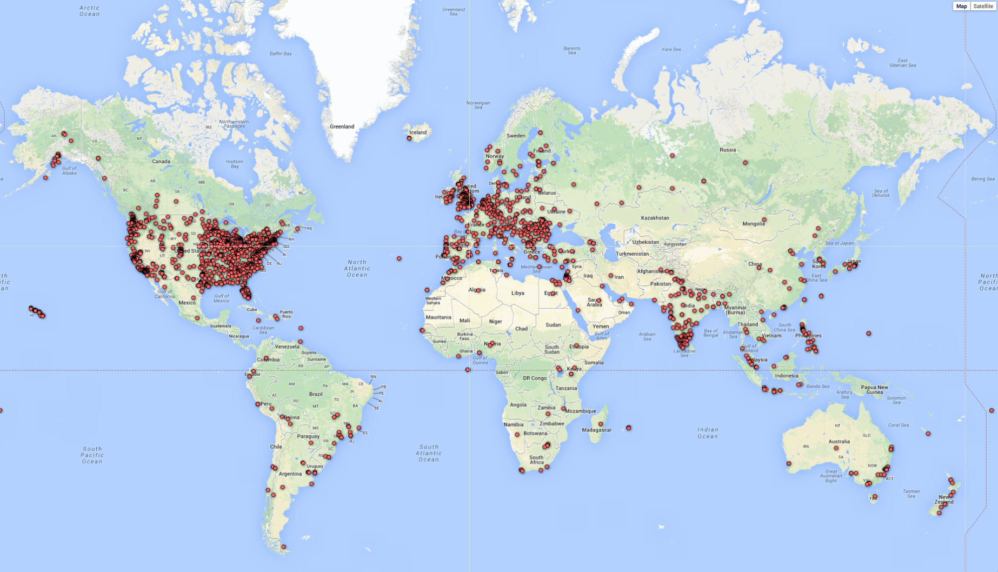
Bias in Collection Data
Wait, we thought data was supposed to help me be objective?
Amazon's recruiting machine learning system was biased against women.
Self-driving Uber car that hit and killed woman did not recognize that pedestrians jaywalk.
Racial Discrimination in Face Recognition Technology.

Slide 18
Bias in Annotation
The physician was speaking with the secretary about …….. son.
The physician was speaking with the secretary about her son.
The physician was speaking with the secretary about his son.

Slide 19
Bias in all NLP steps
Training data are collected and annotated
Model is Trained
Interpretation
Human Bias

Slide 20
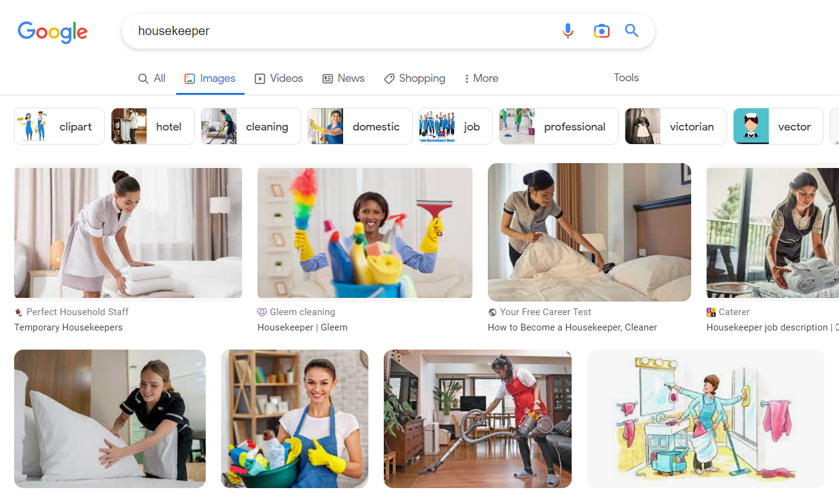
Bias in Interpretation
Biased statement
All housekeepers are women

Slide 21
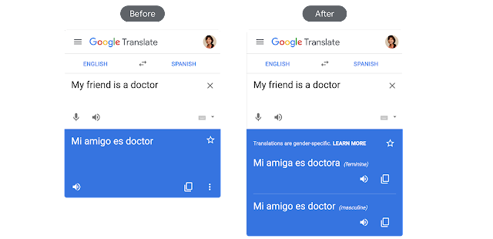
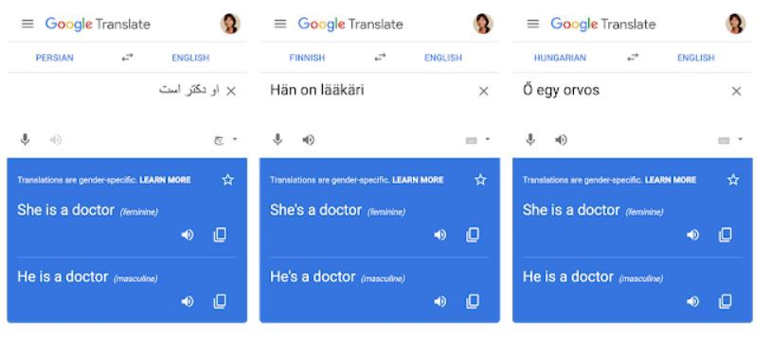
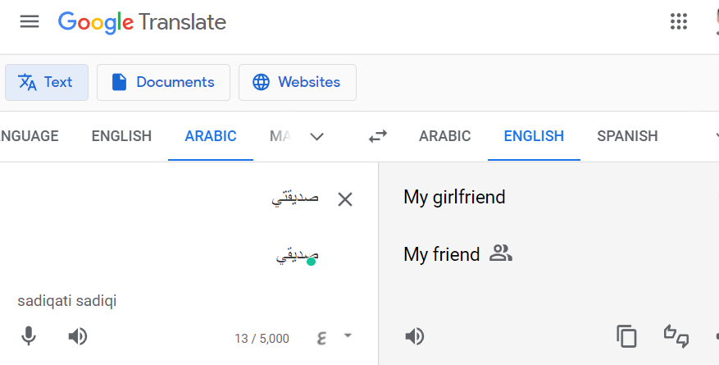
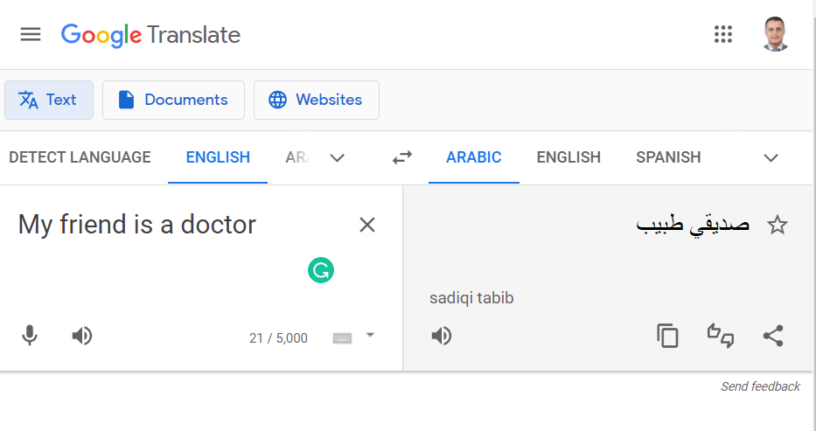
How can we reduce gender bias in NLP systems

Slide 22
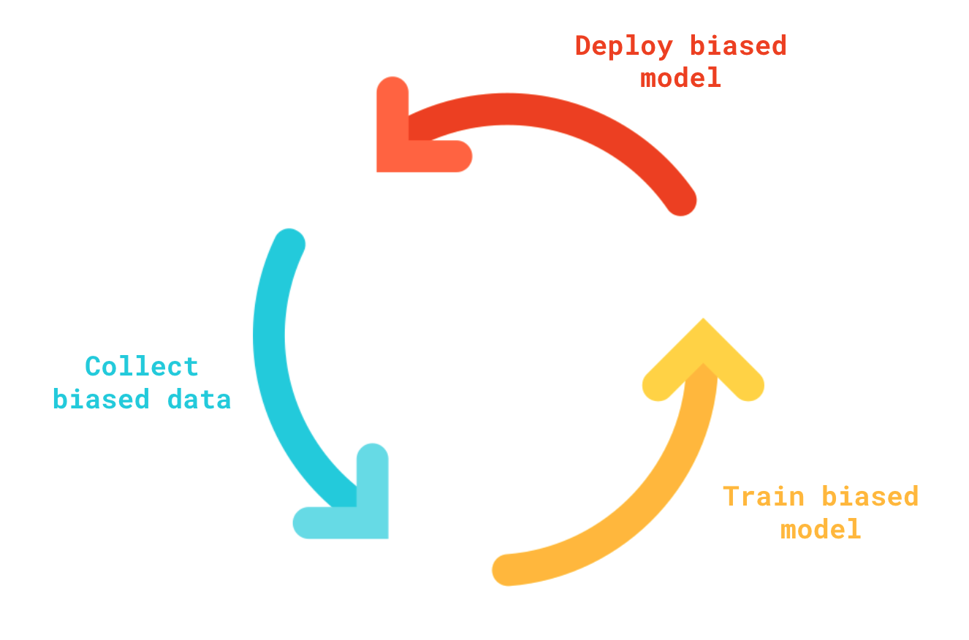
Human data perpetuates human biases NLP learns from human data, the results is a biased loo

Slide 23
How to mitigate gender/racial bias in NLP?
Evaluation of Gender Bias in Word Embeddings

Slide 24
Vector Embedding of Words
A word is represented as a vector.
Word embeddings depend on a notion of word similarity.
Similarity is computed using cosine.
A very useful definition is paradigmatic similarity:
Similar words occur in similar contexts. They are exchangeable.
POTUS
Yesterday The President called a press conference.
Trump
“POTUS: President of the United States.”

Slide 25
Vector Embedding of Words
Traditional Method - Bag of Words Model
Word Embeddings
Either uses one hot encoding.
Each word in the vocabulary is represented by one bit position in a HUGE vector.
For example, if we have a vocabulary of 10000 words, and “Hello” is the 4th word in the dictionary, it would be represented by: 0 0 0 1 0 0 . . . . . . . 0 0 0
Or uses document representation.
Each word in the vocabulary is represented by its presence in documents.
For example, if we have a corpus of 1M documents, and “Hello” is in 1th, 3th and 5th documents only, it would be represented by: 1 0 1 0 1 0 . . . . . . . 0 0 0
Context information is not utilized.
Stores each word in as a point in space, where it is represented by a dense vector of fixed number of dimensions (generally 300) .
Unsupervised, built just by reading huge corpus.
For example, “Hello” might be represented as : [0.4, -0.11, 0.55, 0.3 . . . 0.1, 0.02].
Dimensions are basically projections along different axes, more of a mathematical concept.

Slide 26

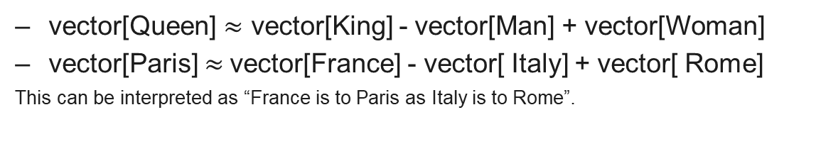
Example
vector[Queen] $≈$ vector[King] - vector[Man] + vector[Woman]
vector[Paris] $≈$vector[France] - vector[ Italy] + vector[ Rome]
This can be interpreted as “France is to Paris as Italy is to Rome”.

Slide 27
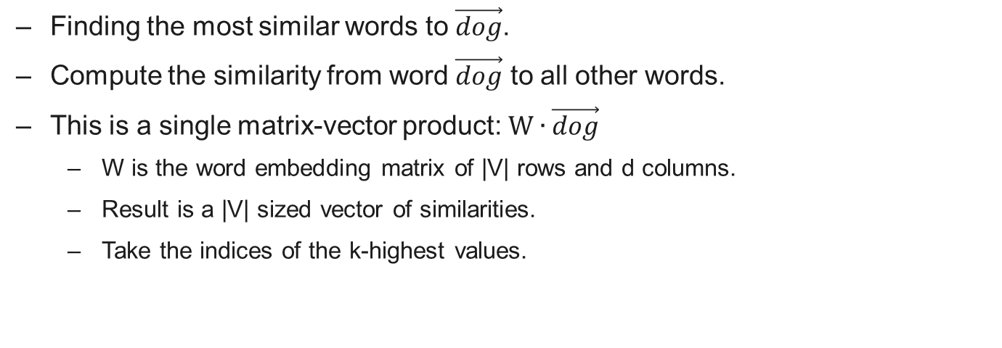
Working with vectors
Finding the most similar words to $\vec{dog}$.
Compute the similarity from word $\vec{dog}$ to all other words.
This is a single matrix-vector product: $W∙\vec{dog}$
W is the word embedding matrix of |V| rows and d columns.
Result is a |V| sized vector of similarities.
Take the indices of the k-highest values.

Slide 28
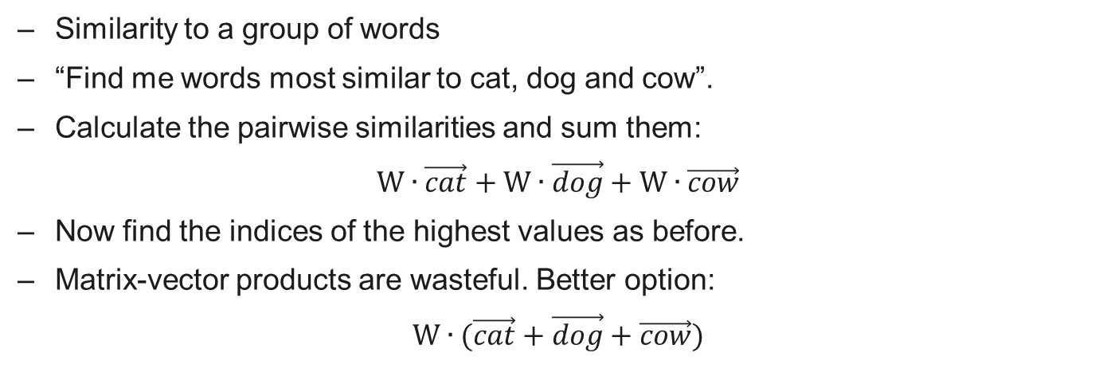
Working with vectors
Similarity to a group of words
“Find me words most similar to cat, dog and cow”.
Calculate the pairwise similarities and sum them:
$$W∙\vec{cat}+W∙\vec{dog}+W∙\vec{cow}$$
Now find the indices of the highest values as before.
Matrix-vector products are wasteful. Better option:
$$W∙(\vec{cat}+\vec{dog}+\vec{cow})$$

Slide 29
Applications of Word Vectors
Word Similarity
Machine Translation
Part-of-Speech and Named Entity Recognition
Relation Extraction
Sentiment Analysis
Co-reference Resolution
Chaining entity mentions across multiple documents - can we find and unify the multiple contexts in which mentions occurs?
Clustering
Words in the same class naturally occur in similar contexts, and this feature vector can directly be used with any conventional clustering algorithms (K-Means, agglomerative, etc). Human doesn’t have to waste time hand-picking useful word features to cluster on.
Semantic Analysis of Documents
Build word distributions for various topics, etc.

Slide 30
Vector Embedding of Words
In this lecture will describe the Word2Vec:
Prediction-based model.
Consider occurrences of terms at context level.

Slide 31
word2Vec: Local contexts
Instead of entire documents, Word2Vec uses words k positions away from each center word.
These words are called context words.
Example for k=3:
“It was a bright cold day in April, and the clocks were striking”.
Center word: red (also called focus word).
Context words: blue (also called target words).
Word2Vec considers all words as center words, and all their context words.

Slide 32
Word2Vec: Data generation (window size = 2)
word | Word one hot encoding | neighbor | Neighbor one hot encoding
king | [1,0,0,0,0,0] | brave | [0,1,0,0,0,0]
king | [1,0,0,0,0,0] | man | [0,0,1,0,0,0]
brave | [0,1,0,0,0,0] | king | [1,0,0,0,0,0]
brave | [0,1,0,0,0,0] | man | [0,0,1,0,0,0]
man | [0,0,1,0,0,0] | king | [1,0,0,0,0,0]
man | [0,0,1,0,0,0] | brave | [0,1,0,0,0,0]
queen | [0,0,0,1,0,0] | beautiful | [0,0,0,0,1,0]
queen | [0,0,0,1,0,0] | women | [0,0,0,0,0,1]
beautiful | [0,0,0,0,1,0] | queen | [0,0,0,1,0,0]
beautiful | [0,0,0,0,1,0] | women | [0,0,0,0,0,1]
woman | [0,0,0,0,0,1] | queen | [0,0,0,1,0,0]
woman | [0,0,0,0,0,1] | beautiful | [0,0,0,0,1,0]
Example:
d1 = “king brave man” , d2 = “queen beautiful women”

Slide 33
Word2Vec: Data generation (window size = 2)
word | Word one hot encoding | neighbor | Neighbor one hot encoding
king | [1,0,0,0,0,0] | brave | [0,1,1,0,0,0]
 |  | man
brave | [0,1,0,0,0,0] | king | [1,0,1,0,0,0]
 |  | man
man | [0,0,1,0,0,0] | king | [1,1,0,0,0,0]
 |  | brave
queen | [0,0,0,1,0,0] | beautiful | [0,0,0,0,1,1]
 |  | women
beautiful | [0,0,0,0,1,0] | queen | [0,0,0,1,0,1]
 |  | women
woman | [0,0,0,0,0,1] | queen | [0,0,0,1,1,0]
 |  | beautiful
Example:
d1 = “king brave man” , d2 = “queen beautiful women”

Slide 34
Word2Vec: main context representation models
Input
Output
W₋₂
W₋₂
W₋₁
Output
Input
W₋₁
Sum and projection
Projection
w₀
w₀
w₁
w₁
w₂
w₂
Word2Vec is a predictive model.
Will focus on Skip-Ngram model

Slide 35
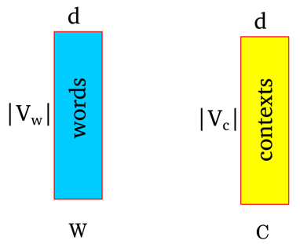
How does word2Vec work?
Represent each word as a d dimensional vector.
Represent each context as a d dimensional vector.
Initialize all vectors to random weights.
Arrange vectors in two matrices, W and C.

Slide 36
Word2Vec : Neural Network representation
Input layer
Hidden layer
Output (sigmoid)
|V_{w}|
|V_{c}|
w1
w2

Slide 37
Word2Vec : Neural Network representation
Input layer
Hidden layer
Output (sigmoid)
king
1
0
|V_{w}|
|V_{c}|
0
1
brave
0
w1
1
man
0
w2
0
0
0
0
0

Slide 38
Word2Vec : Neural Network representation
Input layer
Hidden layer
Output (sigmoid)
0
1
king
|V_{w}|
|V_{c}|
brave
1
0
0
w1
1
man
0
w2
0
0
0
0
0

Slide 39
Word2Vec : Neural Network representation
Input layer
Hidden layer
Output (sigmoid)
0
1
king
|V_{w}|
|V_{c}|
0
1
brave
man
1
w1
0
0
w2
0
0
0
0
0

Slide 40
Word2Vec : Neural Network representation
Input layer
Hidden layer
Output (sigmoid)
0
0
|V_{w}|
|V_{c}|
0
0
0
w1
0
queen
1
w2
0
0
1
beautiful
0
1
women

Slide 41
Word2Vec : Neural Network representation
Input layer
Hidden layer
Output (sigmoid)
0
0
|V_{w}|
|V_{c}|
0
0
0
w1
0
0
w2
1
queen
beautiful
1
0
0
1
women

Slide 42
Word2Vec : Neural Network representation
Input layer
Hidden layer
Output (sigmoid)
0
0
|V_{w}|
|V_{c}|
0
0
0
w1
0
0
w2
1
queen
1
1
beautiful
women
0
0

Slide 43
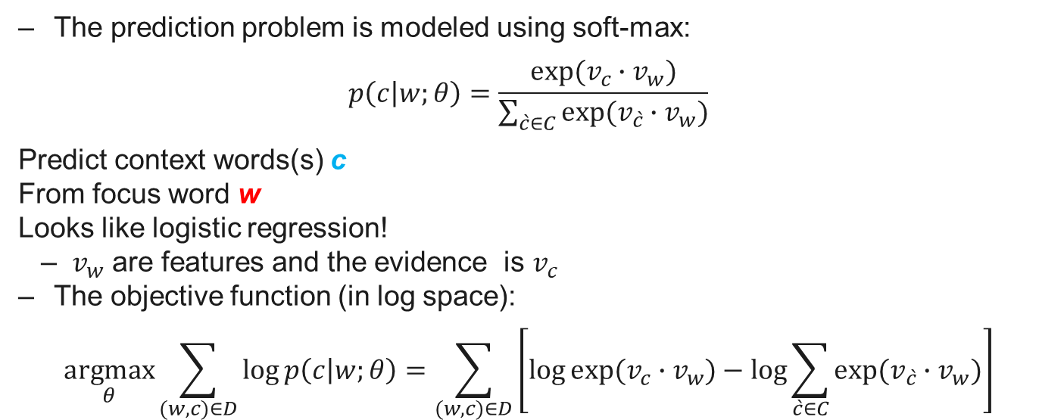
Skip-Ngram: Training method
The prediction problem is modeled using soft-max:
$$p\left(c | w;θ\right)=\frac{exp⁡(v_{c}∙v_{w})}{\sum_{\grave{c}∈C}{exp⁡(v_{\grave{c}}∙v_{w})}}$$
Predict context words(s) c
From focus word w
Looks like logistic regression!
$v_{w}$ are features and the evidence is $v_{c}$
The objective function (in log space):
$$\underset{θ}{argmax}{\sum_{(w,c)∈D}{\log{p\left(c | w;θ\right)}}=\sum_{(w,c)∈D}{\left[\log{exp⁡(v_{c}∙v_{w})}−\log{\sum_{\grave{c}∈C}{exp⁡(v_{\grave{c}}∙v_{w})}}\right]}}$$

Slide 44
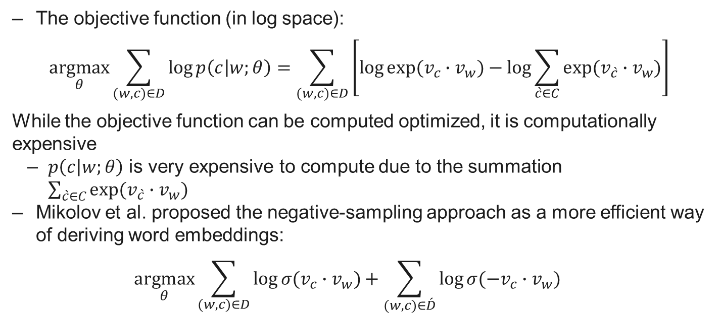
Skip-Ngram: Negative sampling
The objective function (in log space):
$$\underset{θ}{argmax}{\sum_{(w,c)∈D}{\log{p\left(c | w;θ\right)}}=\sum_{(w,c)∈D}{\left[\log{exp⁡(v_{c}∙v_{w})}−\log{\sum_{\grave{c}∈C}{exp⁡(v_{\grave{c}}∙v_{w})}}\right]}}$$
While the objective function can be computed optimized, it is computationally expensive
$p\left(c | w;θ\right)$ is very expensive to compute due to the summation $\sum_{\grave{c}∈C}{exp⁡(v_{\grave{c}}∙v_{w})}$
Mikolov et al. proposed the negative-sampling approach as a more efficient way of deriving word embeddings:
$$\underset{θ}{argmax}{\sum_{(w,c)∈D}{\log{⁡σ(v_{c}∙v_{w})}+\sum_{(w,c)∈\acute{D}}{\log{⁡σ(−v_{c}∙v_{w})}}}}$$

Slide 45
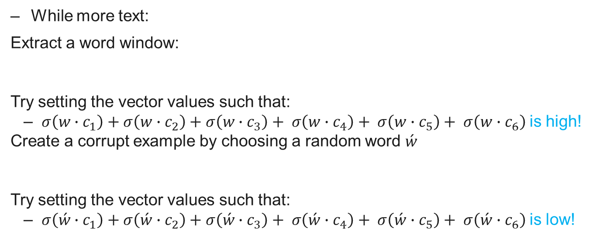
Skip-Ngram: Example
While more text:
Extract a word window:
Try setting the vector values such that:
$σ\left(w∙c_{1}\right)+σ\left(w∙c_{2}\right)+σ\left(w∙c_{3}\right)+ σ\left(w∙c_{4}\right)+ σ\left(w∙c_{5}\right)+ σ\left(w∙c_{6}\right)$is high!
Create a corrupt example by choosing a random word $\acute{w}$
Try setting the vector values such that:
$σ\left(\acute{w}∙c_{1}\right)+σ\left(\acute{w}∙c_{2}\right)+σ\left(\acute{w}∙c_{3}\right)+ σ\left(\acute{w}∙c_{4}\right)+ σ\left(\acute{w}∙c_{5}\right)+ σ\left(\acute{w}∙c_{6}\right)$is low!

Slide 46
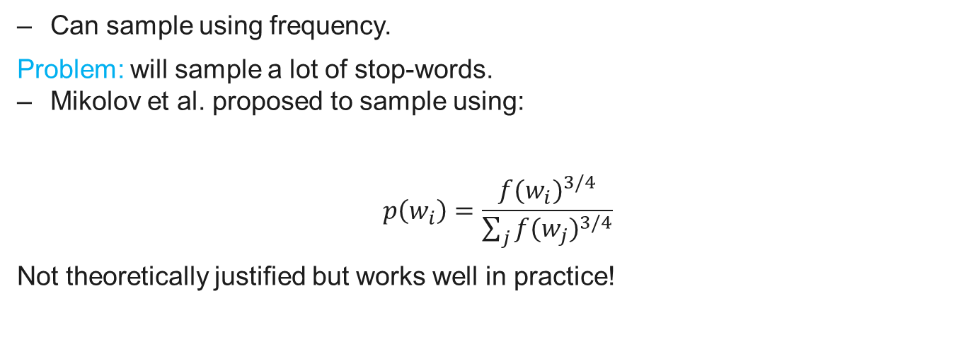
Skip-Ngram: How to select negative samples?
Can sample using frequency.
Problem: will sample a lot of stop-words.
Mikolov et al. proposed to sample using:
$$p\left(w_{i}\right)=\frac{{f(w_{i})}^{3/4}}{\sum_{j}{{f(w_{j})}^{3/4}}}$$
Not theoretically justified but works well in practice!

Slide 47
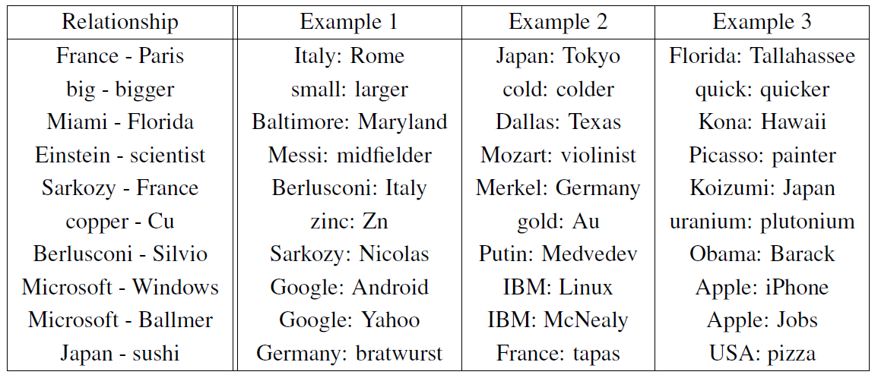
Relations Learned by Word2Vec
A relation is defined by the vector displacement in the first column. For each start word in the other column, the closest displaced word is shown.
“Efficient Estimation of Word Representations in Vector Space” Tomas Mikolov, Kai Chen, Greg Corrado, Jeffrey Dean, Arxiv 2013

